Slide 1
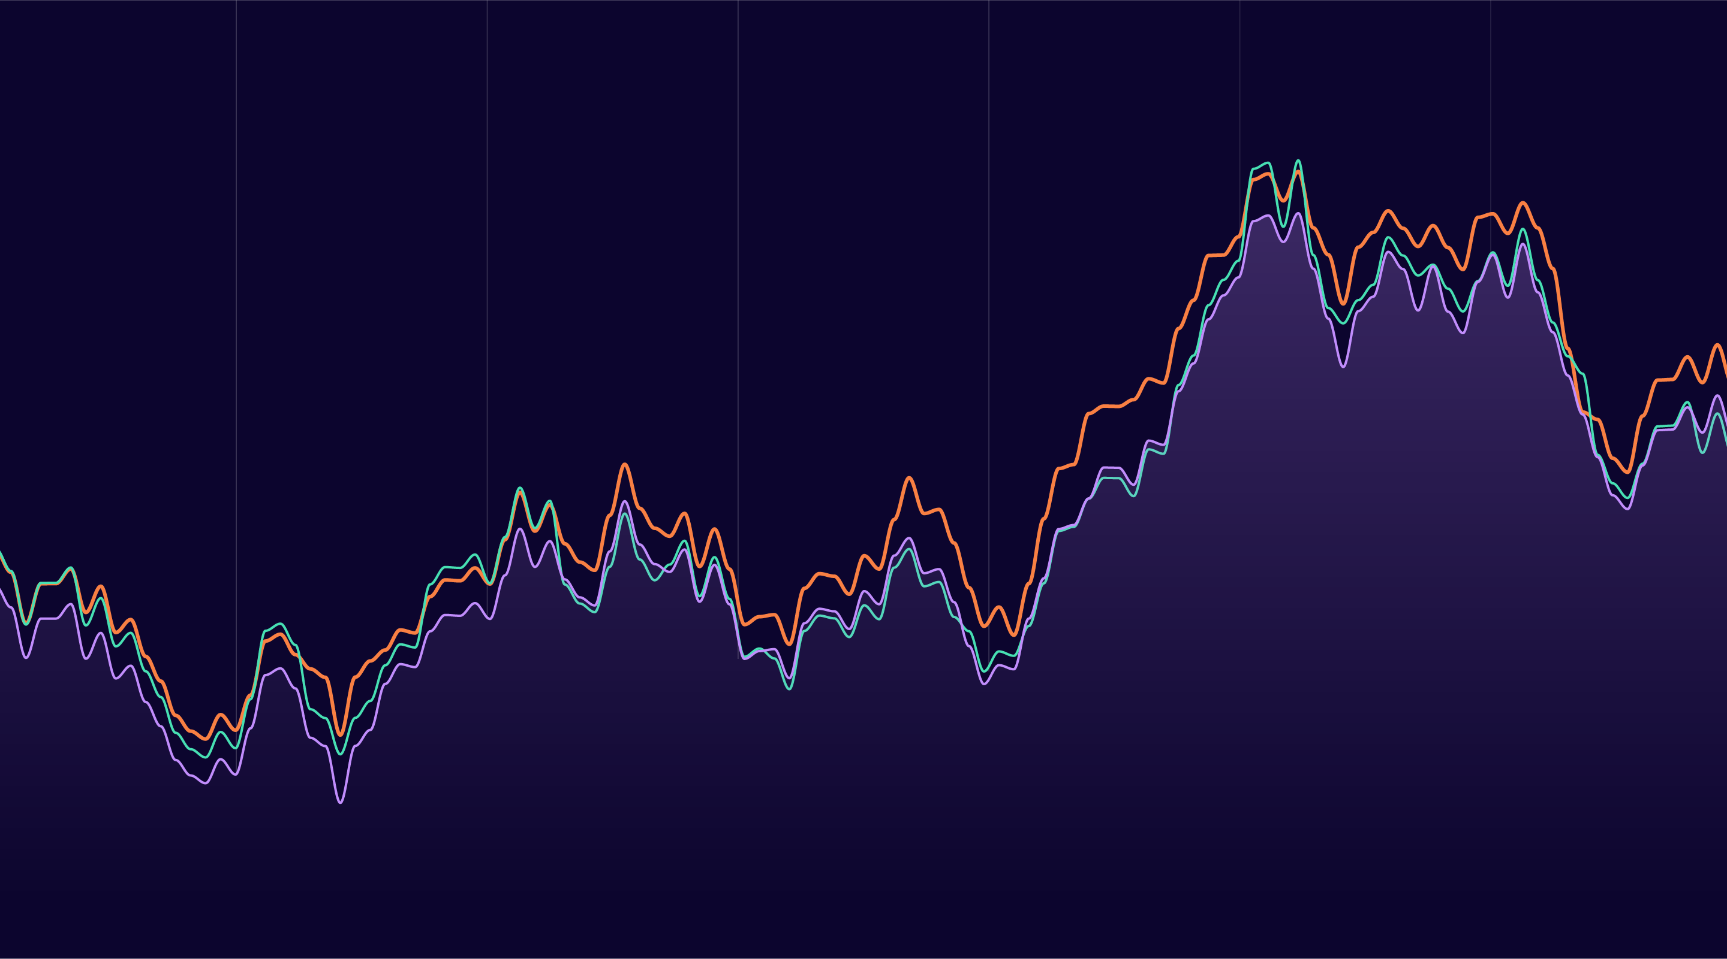
TIME SERIES ANALYSIS
Electric Transformer Temperature Forecasting
Nihaar Nandedkar
Notes:
The topic of my final project is electric transformer temperature forecasting

Slide 2
MAIN IDEA OF PROJECT
Predicting power demand is difficult as it varies with lots of factors like weekdays, holidays, seasons, weather etc.
No existing method can provide a long term prediction with high precision.
Leads to power wastage as equipment is run at higher settings as a precaution.
Oil temperature can reflect the efficiency of electric transformer. Maintaining the correct temperature can reduce power wastage.
Build several models to forecast the oil temperature that should be maintained based on external power load features.
Notes:
So just to give you an idea of what that is.. Historically predicting the power demand for any region has been a challenging problem due to a lot of different factors that can potentially affect the demand and even with the advanced analytical methods available today its difficult to get an accurate long-term prediction for the forecast. So what power plants generally do is produce more power than is consumed which effectively leads to a wastage of power. So to avoid this wastage, the oil temperature inside the electrical transformer can be measured to determine how efficiently the power is being generated and maintaining the correct oil temperature reduces power wastage. In my project I have built a model that considers external power load features of a transformer and forecasts the oil temperature that should be maintained for achieving high efficiency.

Slide 3
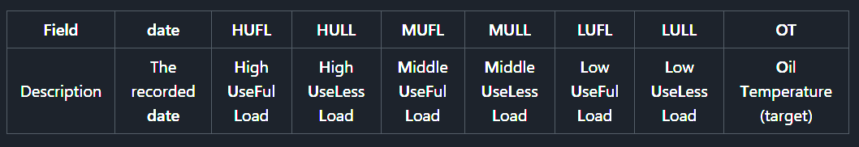
Dataset description
Real world dataset from a power generation facility in China.
Dataset obtained from github.com
Hourly data from 1st July 2016 – 28th June 2018.
Aggregated to daily data for ease of modelling.
Dataset contains 8 columns which are as follows -
Notes:
The dataset I have used is a real world dataset obtained from a power generation facility in China. I found the dataset on github and it contains hourly data from the 1st July 2016 to 28th June 2018 approx. 17500 rows. For ease of analysis and modelling I aggregated the data to daily by taking the mean of each column over 24 hours. The dataset contains 8 columns which you can see in the table. Useful load means when there was actually a demand for power and useless lad means when there was no demand for power.

Slide 4
HYPOTHESIS TO TEST
Target variable oil temperature follows a seasonal trend over the years.
Other predictor variables follow a weekly trend.
Target variable oil temperature depends on the previous days oil temperature.
Target variable oil temperature is influenced by the lagged values of external power load features associated with the electric transformer.
Notes:
The hypothesis that I’ll be testing through this project is whether the target variable and external load factors follow any kind of trend like daily, weekly or seasonal? I’ll also be testing if the oil temperature is influenced by the previous days oil temperature and other external load factors present in the dataset.

Slide 5
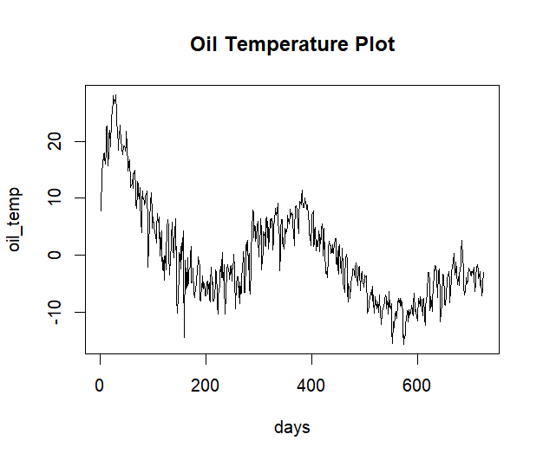
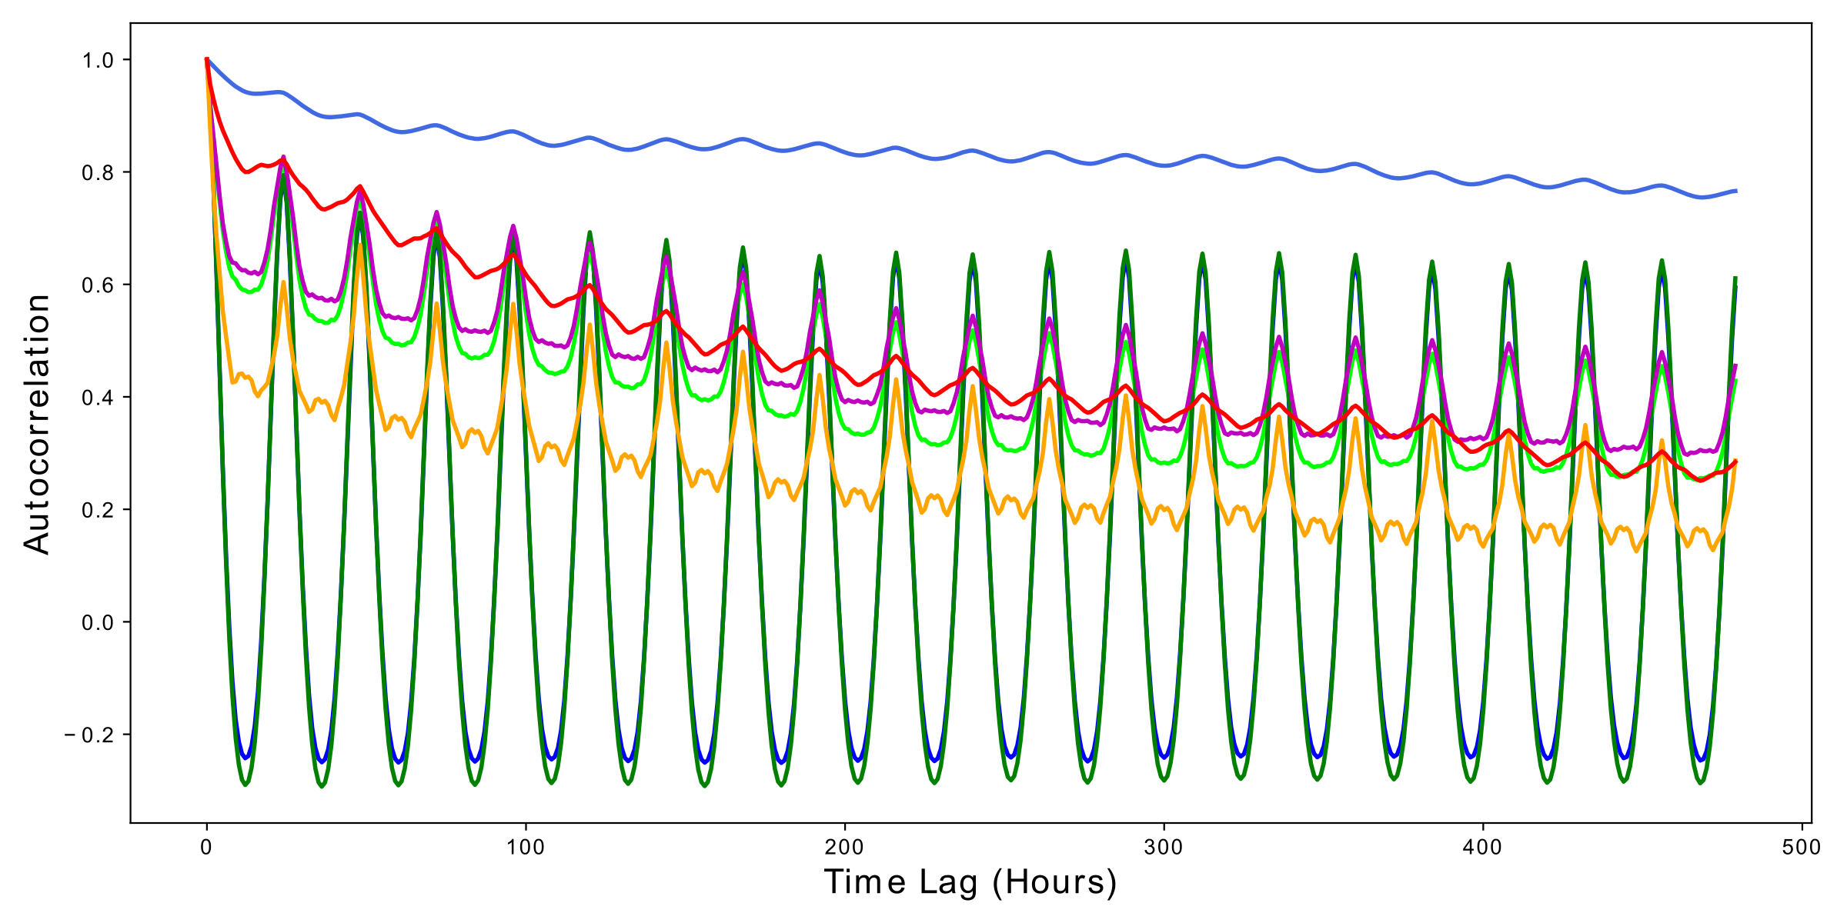
EDA OF TIME SERIES TO CHECK FOR TRENDS
ACF of the independent variables before aggregating shows a daily trend as well as a weekly trend.
Seasonal trend observed. Peaks roughly every 365 days.
Notes:
So to check for any trends I’ve plotted the target variable oil temperature’s time series and a seasonal trend is observed that peaks roughly every 365 days. To checking for any daily or weekly trends in the external load factors I plotted the Auto correlation of the variables before aggregating and from the plot we can observe a daily as well as a weekly trend. The blue line on the top is the oil temperature and that also exhibits a similar trend.

Slide 6
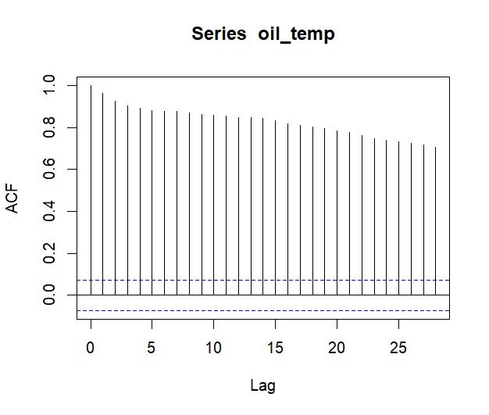
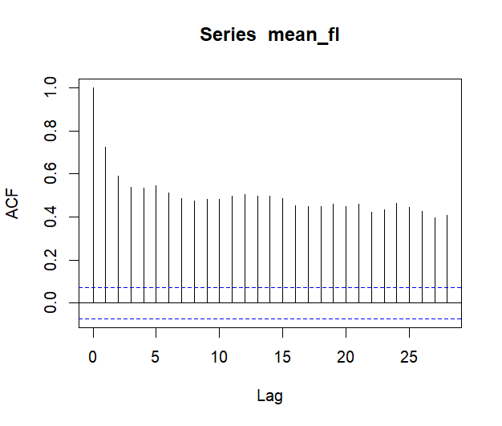
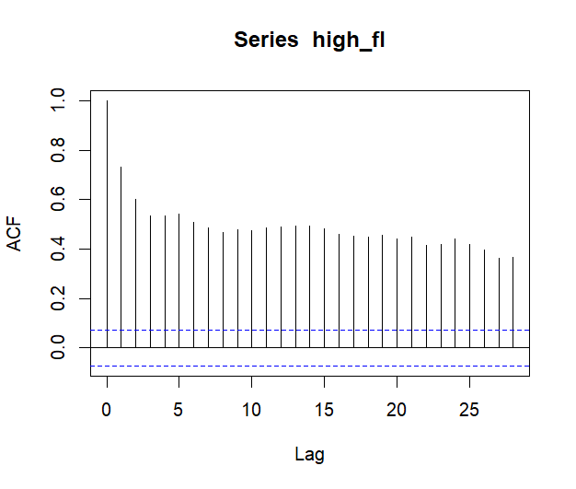
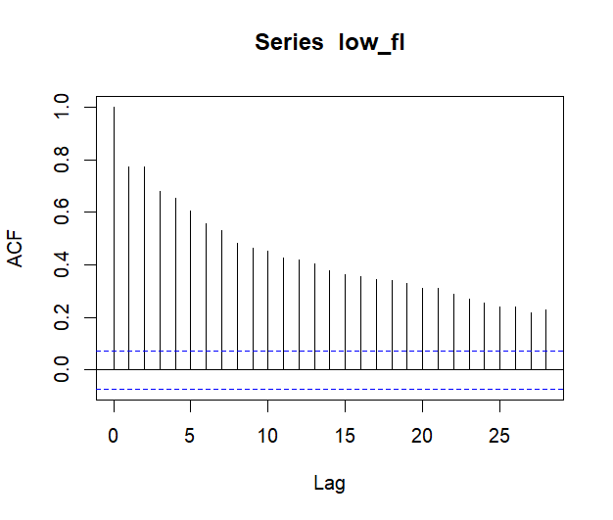
EDA OF TIME SERIES TO CHECK FOR TRENDS
Notes:
Breaking it down into ACF of each variable, as you can see that all the lags are showing as significant that means there is a trend in the data that needs to be removed for making the series stationary in order to make a better model. To achieve stationarity in the series I’ve used differencing.

Slide 7
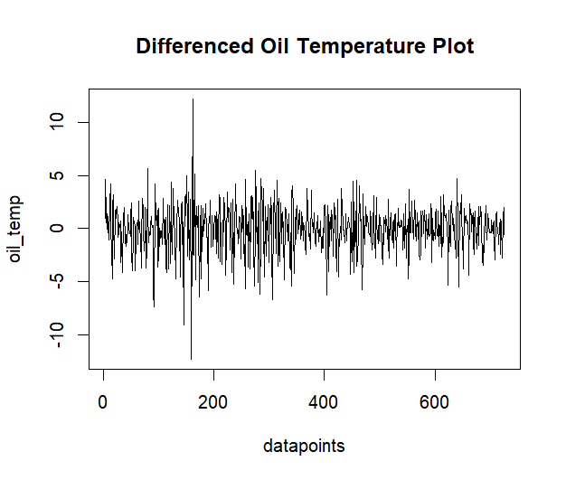
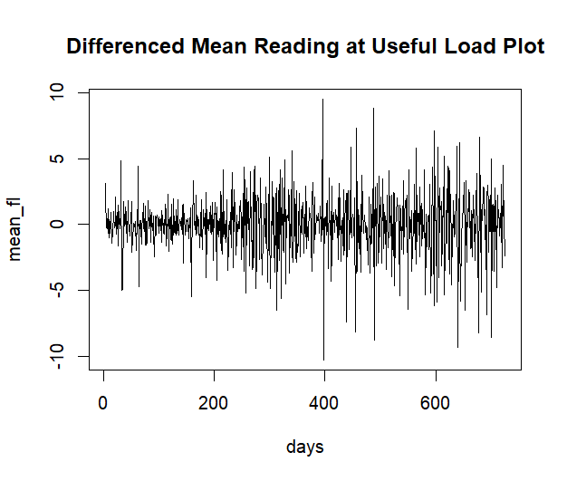
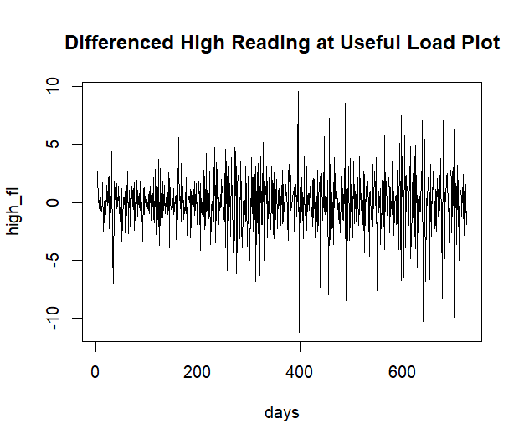
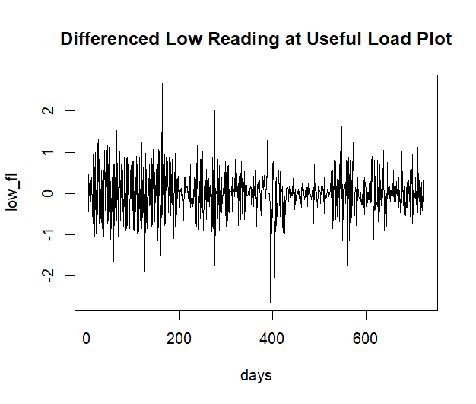
DIFFERENCING TO ACHIEVE STATIONARITY
Notes:
So plotting the time series for each variable after differencing, it is evident from the plots that any daily, weekly or seasonal trend in the variables has been removed.

Slide 8
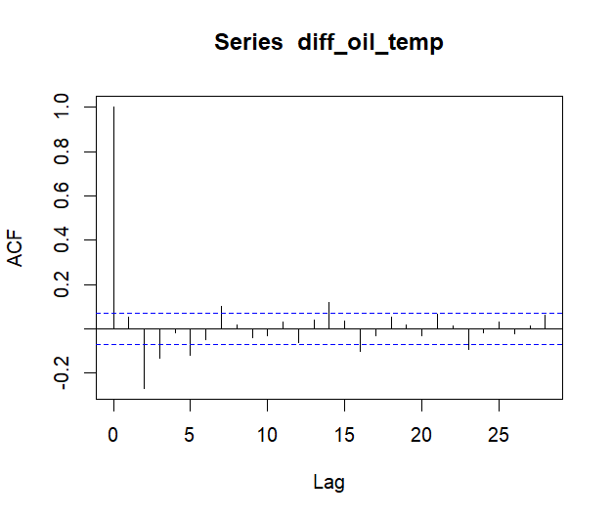
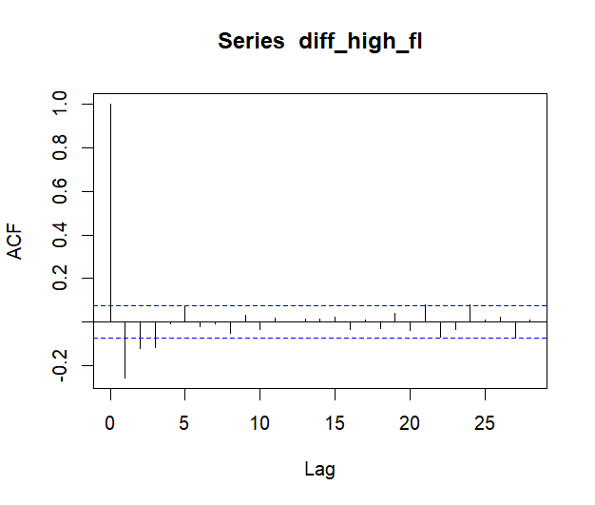
ACF PLOTS POST DIFFERENCING
SIGNIFICANT CORRELATIONS OBSERVED UPTO LAG 3
SIGNIFICANT CORRELATIONS OBSERVED UPTO LAG 4
Notes:
As you can see the Auto correlation of the target as well as the external load factor variables also do not show any trends in them.

Slide 9
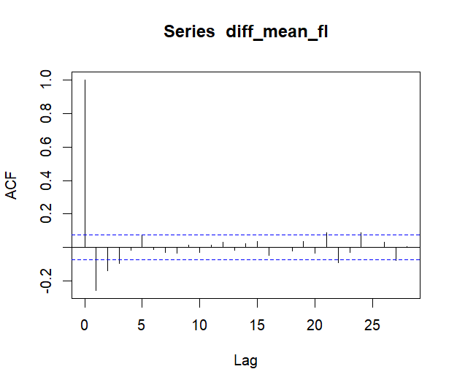
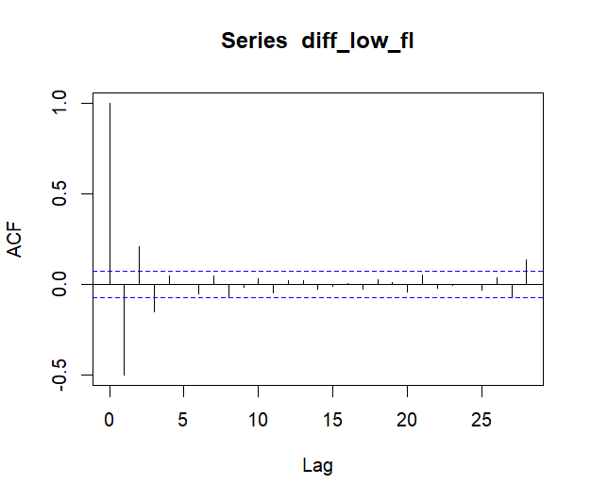
ACF PLOTS POST DIFFERENCING
SIGNIFICANT CORRELATIONS OBSERVED UPTO LAG 4
SIGNIFICANT CORRELATIONS OBSERVED UPTO LAG 3
Notes:
An observation that can be drawn from these ACFs is that the target variable as well as the external load factor variables show significant spikes upto a lag of 4 at the most.

Slide 10
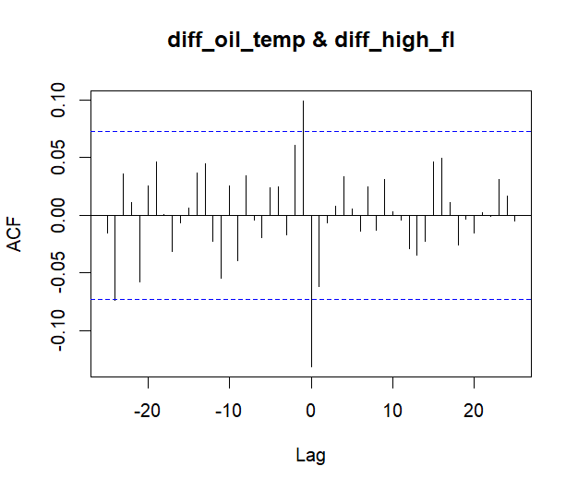
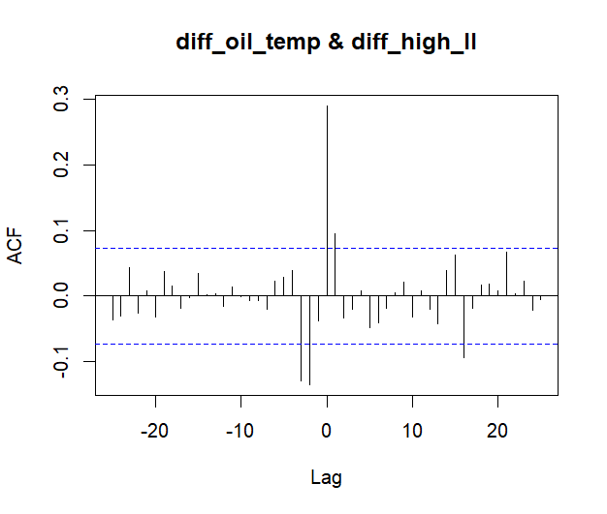
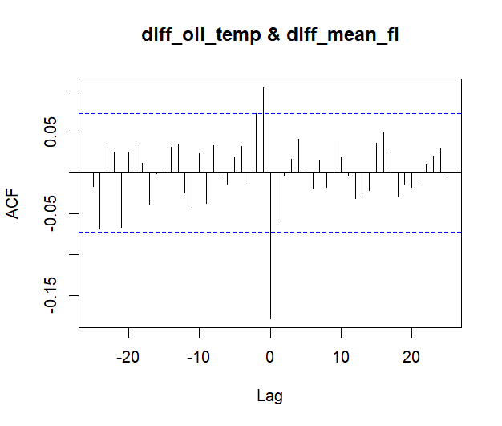
CCF PLOTS POST DIFFERENCING
high_fl is negatively driving oil_temp at lag 0
oil_temp is positively driving high_fl at lag 1
high_ll is positively driving oil_temp at lags 0-1
oil_temp is negatively driving high_ll at lags 2-3
mean_fl is negatively driving oil_temp at lag 0
oil_temp is positively driving mean_fl at lag 1
Notes:
Next I plotted the Cross correlations to understand the influence of the external load factors on the target variable and the influence of the target variable on the external load factors.

Slide 11
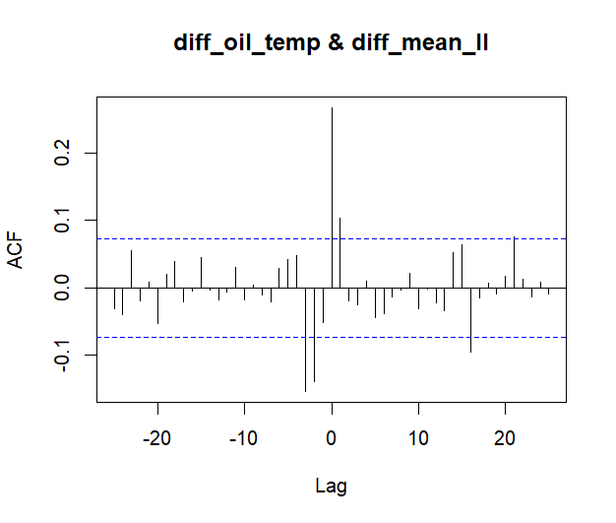
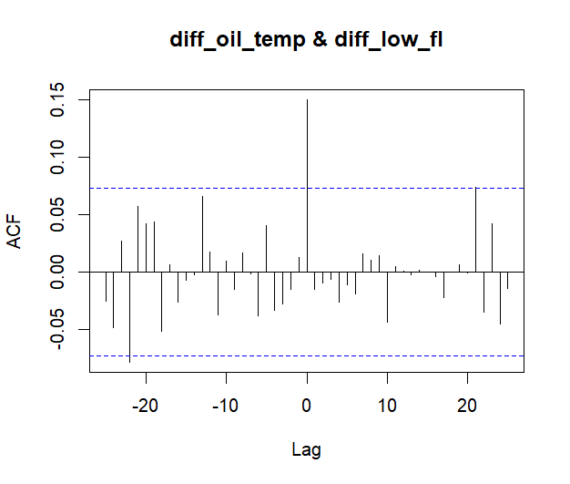
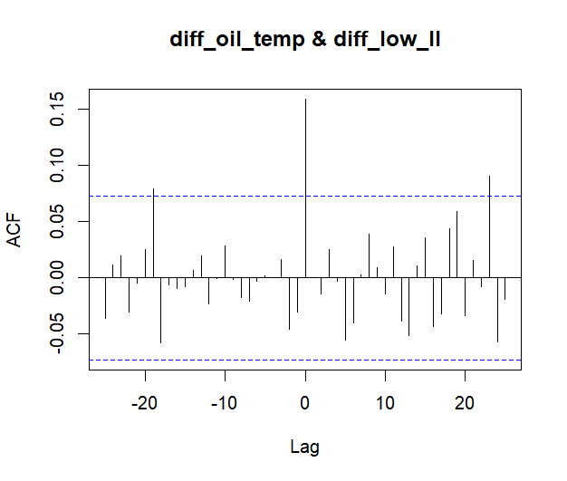
CCF PLOTS POST DIFFERENCING
mean_ll is positively driving oil_temp at lags 0-1
oil_temp is negatively driving mean_ll at lags 2-3
low_fl is positively driving oil_temp at lag 0
oil_temp is positively driving low_fl at lag 0
low_ll is positively driving oil_temp at lag 0
oil_temp is positively driving low_ll at lag 1
Notes:
An observation that can be drawn from these cross correlations is that the target variable as well as the external load factor variables influence each other upto a lag of 3 at the most.

Slide 12
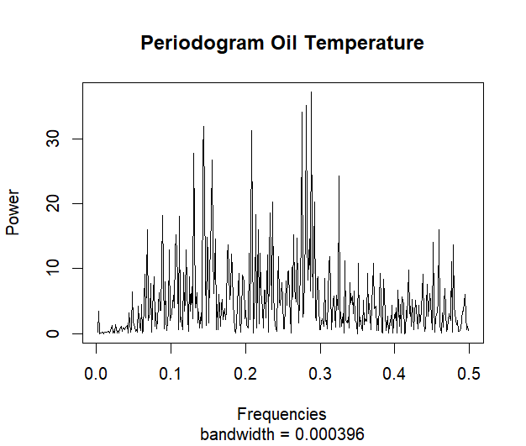
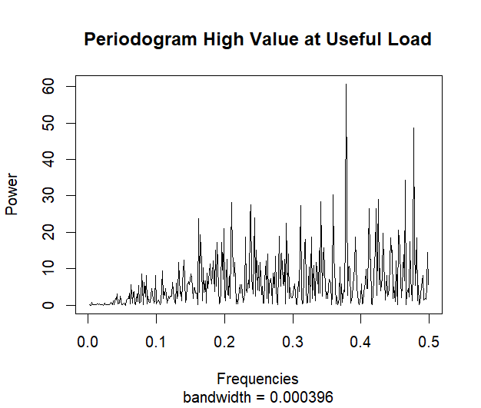
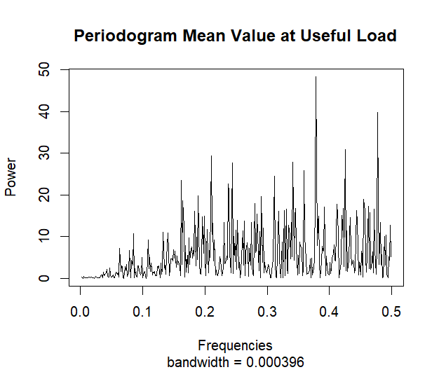
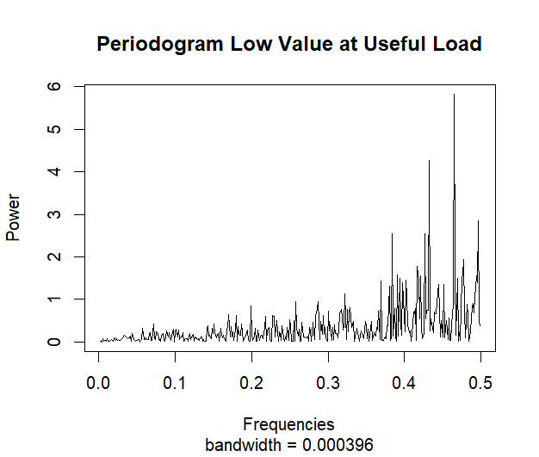
SPECTRAL ANALYSIS
Notes:
And finally, from the spectral analysis of the differenced series, since we don’t observe a higher power at a particular frequency that could potentially indicate a pattern, cycle or unexpected behavior in the data, we can say that the all the series are stationary and thus can be used for modelling.

Slide 13
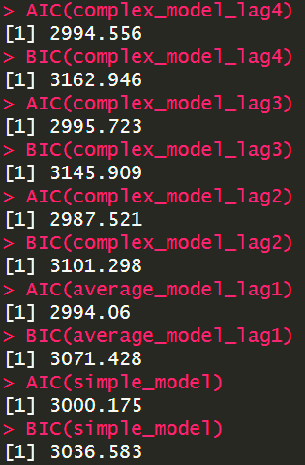
ARIMAX MODEL FITTING
Model 1 – ARMA(3,4) Complex model with 4 lag terms
Model 2 – ARMA(5,5) Complex model with 3 lag terms
Model 3 – ARMA(5,4) Complex model with 2 lag terms
Model 4 – ARMA(4,4) Average model with single lag
Model 5 – ARMA(4,2) White noise model
Orders for all the above models were determined by lopping through all possible p,q values in the range 1-5 and selecting the values for which AIC and BIC scores were the lowest.
From the AIC and BIC scores of the 5 final models, the best one is determined to be model 3.
Notes:
So I created a total of 5 models starting with a model that contained 4 lag terms of each variable and going all the way down to a simple white noise model. The choice for using 4 lag terms for the first model comes from the fact that we observed significant spikes upto a lag of 4 in the ACF and CCF of the differenced series. Next, to determine the best order of each model I looped through the p q values and chose the one with the best AIC and BIC scores. Finally, I compared the 5 models based on their AIC and BIC scores and through that I determined that Model 3 which was an ARMA (5,4) model with 2 lagged terms for each variable is the best model for the problem.

Slide 14
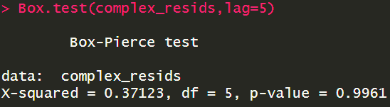
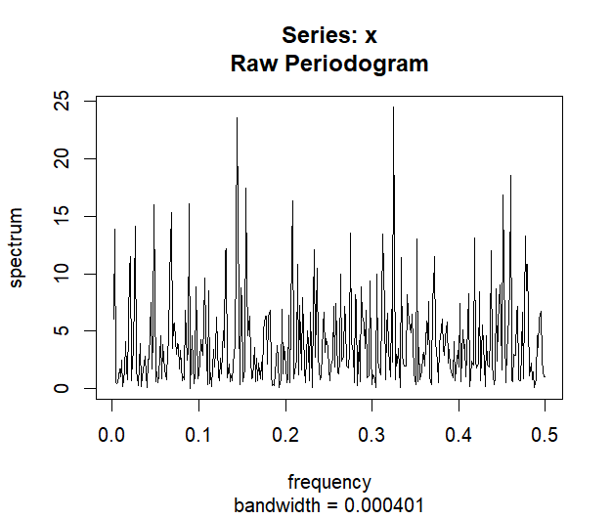
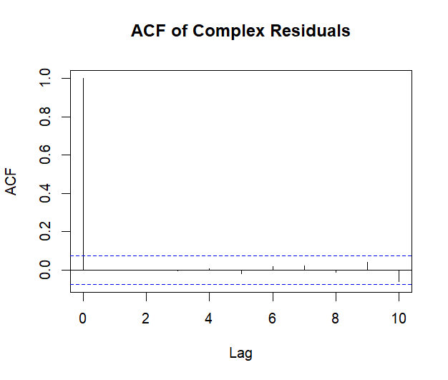
ADDITIONAL CHECKS FOR GOODNESS OF FIT
Box test gives a p-value greater than 0.05 indicating that residuals are independent
Spectral Analysis of residuals shows random walk.
ACF of residuals shows significant spike at lag 0 only.
Notes:
Performing some additional checks for the goodness of fit of this model, we can see that the power spectrum of the model residuals has random spikes indicating that it is a random walk. The ACF shows a significant lag only at lag 0 so there is no trend in the data that the model fails to capture. And since the box test also gives a p-value greater than 0.05, it indicates that residuals are Independent and identically distributed.

Slide 15
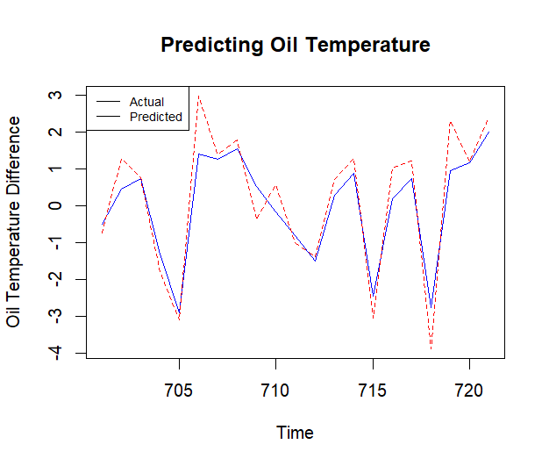
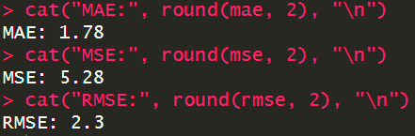
MODEL METRICS AND PREDICTIONS
Since the MAE and RMSE are low, it suggests that the model does a good job at predicting oil temperature.
Notes:
So using the model to predict the oil temperature for the next 20 days, from the plot we can see that model does a pretty good job at forecasting the oil temperature based on the lagged values of the external load factors as well as the oil temperature. The model metrics like Mean absolute error and root mean square error are also low suggesting that the model has a good accuracy for predicting the oil temperature.

Slide 16
CONCLUSIONS
The target variable as well as the external load factors exhibit a daily and weekly trend. Oil temperature also exhibited a seasonal trend.
The oil temperature for a given day is influenced by the lagged values of the oil temperature and other external load factors associated with the transformer.
The model built has a reasonable fit and can be used for predicting the oil temperature.
FUTURE SCOPE
Build a Seasonal ARIMA model and a Vector Autoregressive model for the data and compare performance of each.
Notes:
So to conclude, based on my initial hypothesis of whether there existed any trends in the data, yes….
Another hypothesis that I wanted to test was if the lagged values of the variables influenced the target and yes,
And finally, as we saw through various visualizations, the box test and other model metrics, …
A future scope of this project could involve

